Slide 1
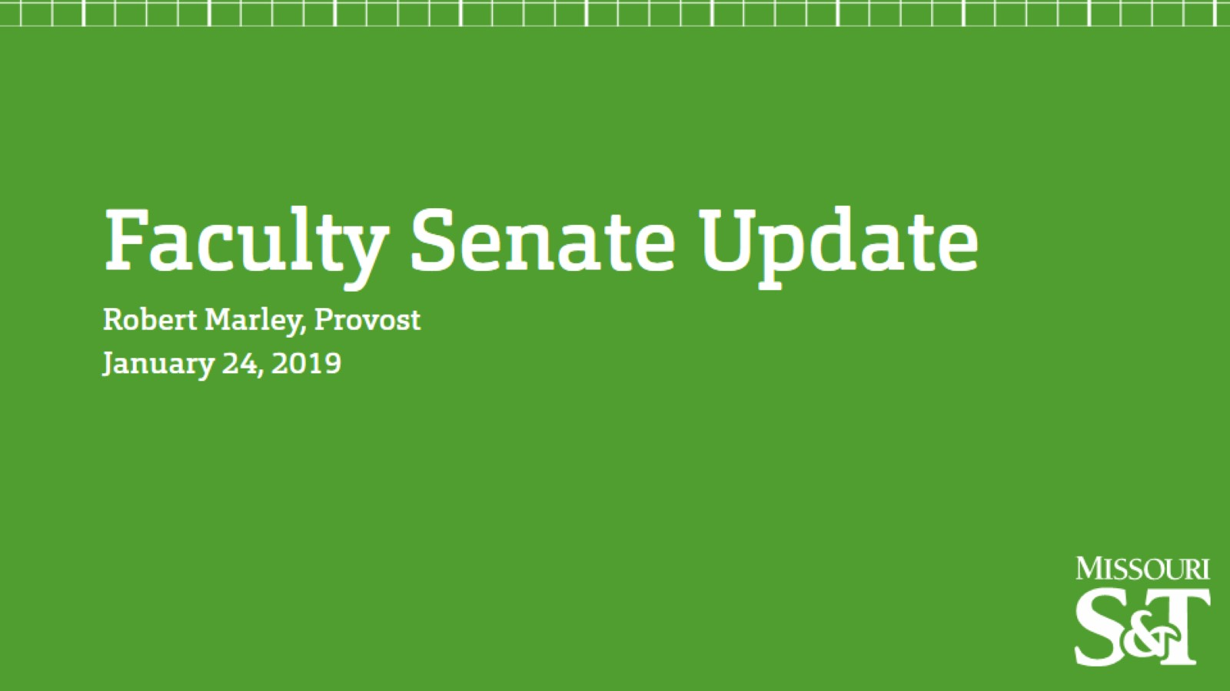

Slide 4
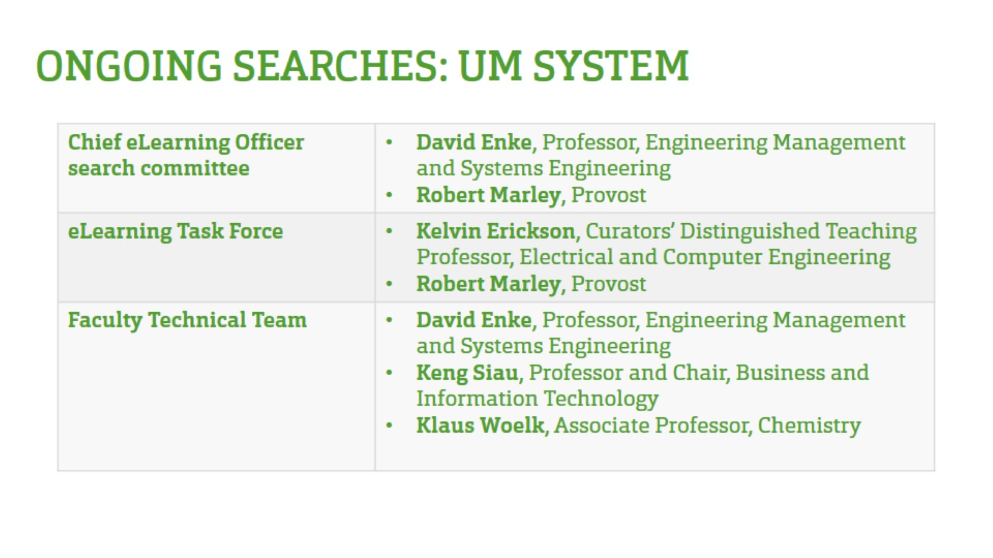

Slide 7
Division Updates
Faculty Senate Meeting
Thursday, January 24, 2019

Slide 8
Center for Advancing Faculty Excellence (CAFE)
December 2018 Update
Major Accomplishments | Immediate Plans
Successful Faculty Awards Banquet on December 4th; 114 attendees, including Campus Faculty Awardees, Outstanding Teaching Awardees, and the winners of a new Sustained Excellence in Outstanding Teaching Award Wayne Huebner became Chair Dec 1, and Larry Gragg will serve as interim assistant chair until June 1, 2019. Early Career Faculty Forum: Dec 12 The Role of Research Centers CAFE visited MSU Engineering Cooperative is extending programs to assist with development of S&T faculty in Springfield. Created TLT Conference planning committee and reviewed proposals for Conference March 14 End-of-semester check in meeting with Master Mentors Dec 13 Conducted check-in meetings with Educational Research Mini-Grant PIs Assisted Provost Office with commencement ceremonies Dec 15 | Solidify details for spring semester events and early career faculty forums Launch pilot program for Ten Steps to Teaching Success by end of January Continue to develop Department Chairs training Conduct assessment and evaluation of Fall 2018 CAFE programming and steps for continuous improvement Attend KEEN conference to explore potential institutional partnership with KEEN Pursue position reclassification for Office Support Associate Launch next round of Educational Research Mini-Grants
 | Upcoming Events
 | Jan 7, Jan 10, Jan 15 Building Blocks workshops for course alignment in partnership with the Instructional Design team Jan 8 Half-day CAFE strategic doing retreat January 17 Develop spring semester plan with Master Mentors team January 30 CERTI Advisory Committee meeting January 30 Early career faculty forum: Goal setting, Honors and Awards

Slide 9
College of Engineering and Computing
Beth Cudney, EMSE Associate Professor, was named a Global Learning Faculty Fellow.
Ashok Midha, MAE Professor, delivered a plenary talk in December at the International Federation for the Theory of Mechanisms and Machines. His talk was titled “ In Search of Fundamentally Robust and Intrinsically Complex Designs in Pursuit of High-Performance Mechanisms and Machine Design.”
Hank Pernicka, MAE Professor's, Ph.D. student Pavel Galchenko, will have a NASA Pathways Fellowship. He is scheduled to start at NASA Wallops soon.
Hank Lee, NUC Associate Professor and Interim Program Director, was invited to give a seminar at the Nondestructive Characterization Institute (NCI) at Lawrence Livermore National Laboratory at Livermore, CA. The title of the talk was, “Advanced Radiation Imaging Research at Missouri S&T.”
Islam El-adaway, CArEE Associate Professor, made the list of ENR Midwest’s 2019 Top Young Professionals. The 20 individuals, all under age 40 are honored for “changing construction, design and academic research.”
Grace Yan, CArEE Assistant Professor, provided an article about weathering a disaster to The Muse, the title is, “How to Be Your Best Professional Self During a Natural Disaster.”
The Center for Advancing Faculty Excellence’s Sustained Excellence in Outstanding Teaching Award was given to, Stephen Gao, GGPE Professor, Gary Mueller, NUC Associate Professor and Joe Stanley, ECE Professor.
Sanjay Madria, CS Professor, authored the book, “Secure Sensor Cloud: Synthesis Lectures on Algorithms and Software in Engineering”, it was published in December and covers eight years of research work.
Bruce McMillin, CS Professor and Interim Chair, Jenifer Leopold, CS Associate Professor, Jonathan Kimball, ECE Professor, Rui Bo, ECE Assistant Professor, were awarded a $1 million grant from the National Science Foundation to further research to strengthen cyber-physical systems. The team is joined by a colleague from Purdue University.

Slide 10
College of Arts, Sciences, and Business
First Year Research Experience (FYRE)
This year (2018-19): 29 teams/10 departments
Arts, Languages, and Philosophy (3)
Biological Sciences (2)
Business and Information Technology (2)
Chemistry (8)
English and Technical Communication (3)
History and Political Science (3)
Mathematics and Statistics (1)
Physics (3)
Psychological Science (3)
Teacher Education and Certification (1)
Students from 7 CASB departments, plus 1 undeclared student and 1 CASB dual major

Slide 11
OFFICE OF ACADEMIC SUPPORT
Preview, Registration, and Orientation (PRO) Day
1st PRO day is February 23rd for spring semester 2019
Students will take the math placement test, learn about the campus, and register for courses.
Opportunities for Undergraduate Research Experience (OURE)
Applications are open and will close on May 1st, 2019
Qualifying students will receive a $500 scholarship
Students must be enrolled with at least 12 credit hours and a gpa of 2.50 or higher
Students must provide a final report and reflection
OURE Fellows Program
Applications are open and will close on March 1st, 2019
S&T Undergraduate Research Conference
Registration is open and will close on March 5th, 2019
The conference will be April 17th in the Havener Center rotunda
Undergraduate Research Day at the Capitol
April 4th, 2019
This is a UM System wide event
11 students with 10 posters will represent S&T

Slide 12
Office of Sponsored Programs
Summary of FY19 activities year-to-date (November)
Number of funded proposals is a total of 145
Total dollars is $17.1M
Number of new proposals submitted is 231
Total dollars is $66.6M
Total expenditures is $18M
Net grant and contract expenditures is $14M
F&A recovered is $4M

Slide 13
Office of Graduate Studies
Graduate Fellows Poster Session
Monday, Feb. 25, 10am-12pm & 1pm-3pm
St. Pat’s A&B, Havener
Graduate Student Travel Fund
Up to $600 in funding for a grad student to attend a conference where they have a paper accepted and will be making a presentation
Students must submit a completed “Graduate Student Travel Fund” form, located at grad.mst.edu/currentstudents/travelfund and include:
Copy of program of study
Conference announcement
Paper acceptance letter
Signatures of Department Chair and College Dean
Eligibility: on-campus, full-time graduate students
All requests must be submitted via email to grad@mst.edu.
Three Minute Thesis (3MT)
Opportunity for graduate students to showcase their research and communication skills.
Three minutes, one slide, in language appropriate to a non-specialist audience
Entry deadline Friday Jan. 25, 2019
Final Round: Thursday, Feb. 7, 5-6pm, Carver-Turner, Havener Center

